Slide 1
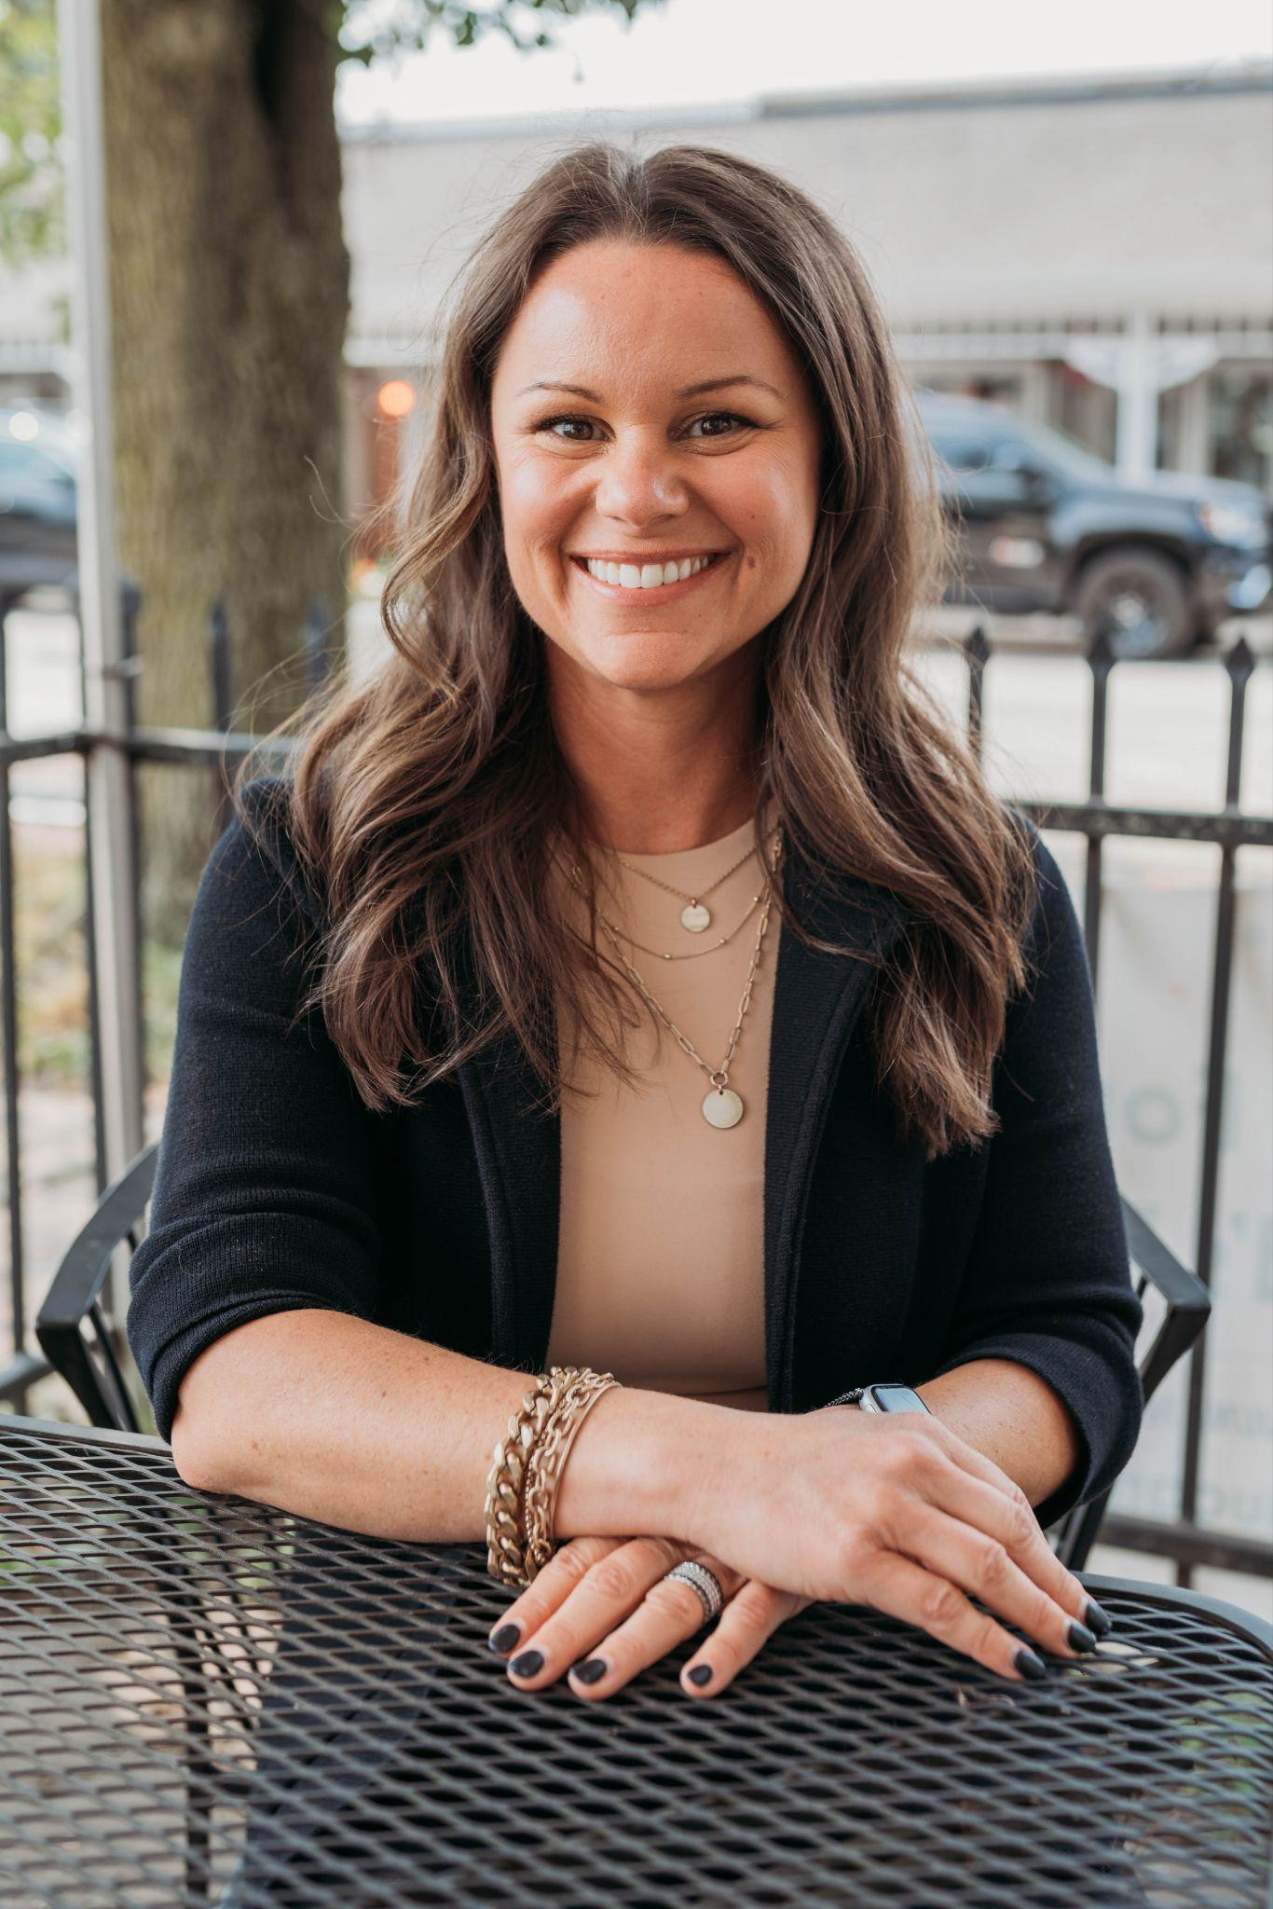
@steviefrank23
Student Driven Podcasts

Slide 2
We’re besties now:

Slide 3
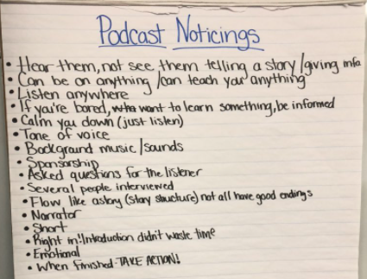
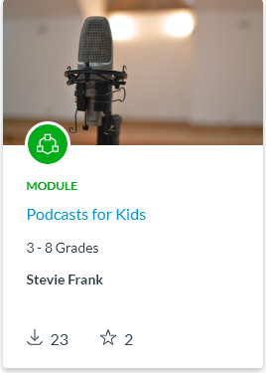
How to teach Podcasts:
Writer’s Workshop style
Start with immersion
Is Canvas your LMS?
I shared these to the commons:

Slide 4
What do YOU want to teach your classmates?

Slide 5
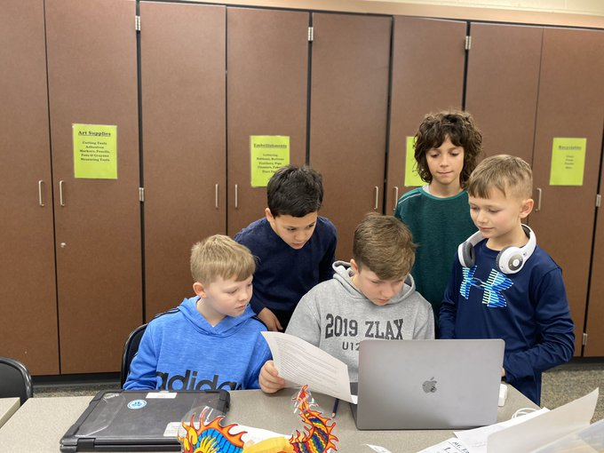
Researching:
Students created a Wakelet
Started researching their topic

Slide 6
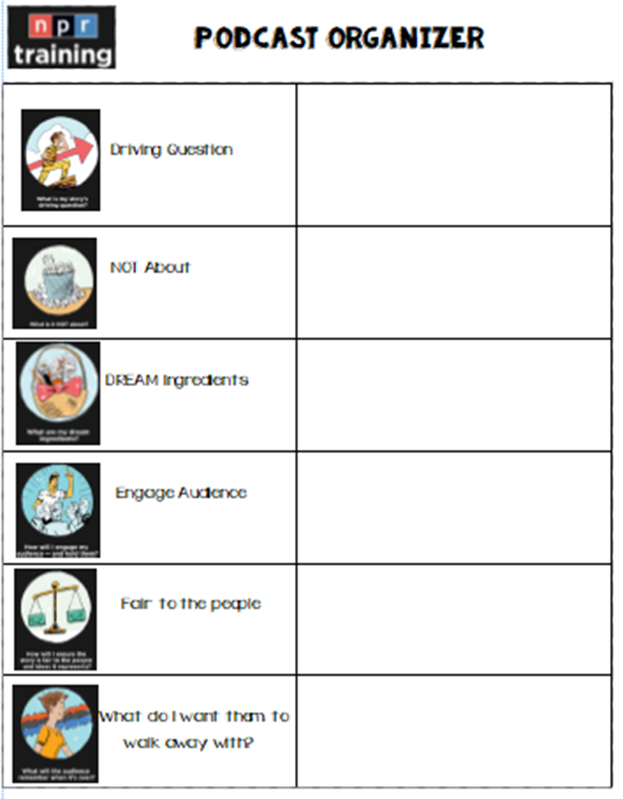
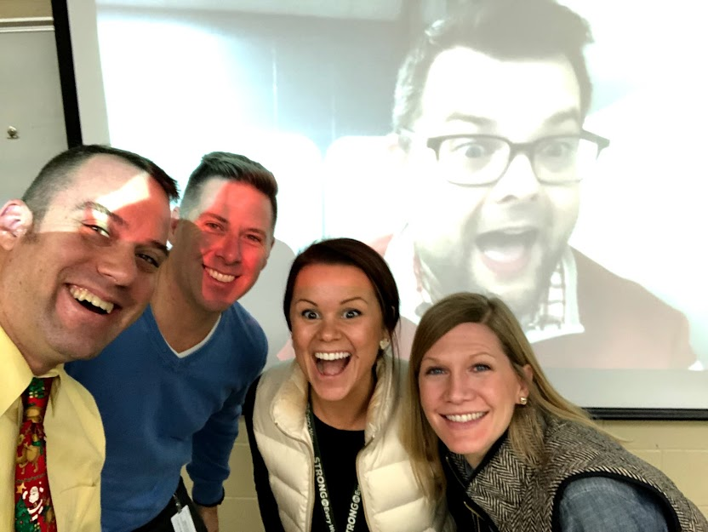
Planning

Slide 7
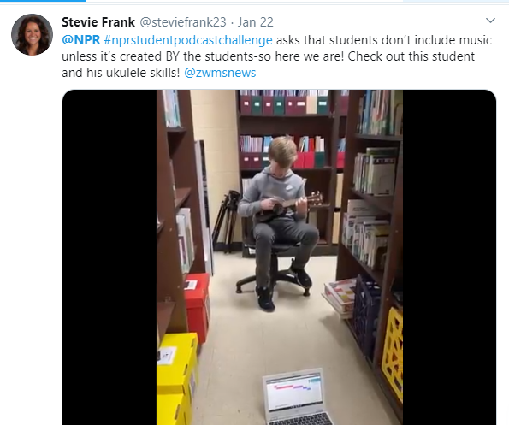
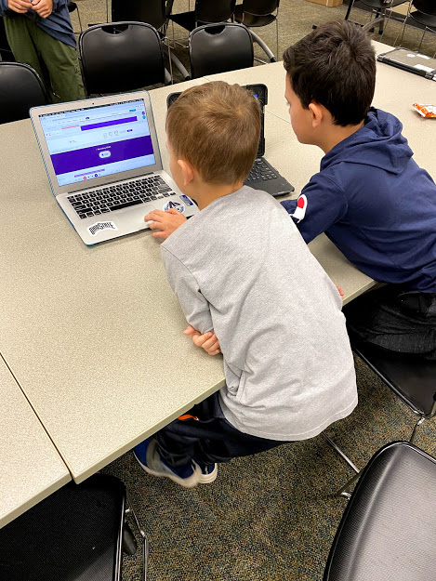
Roles:
Soundtrap Expert
Music expert
Writing expert
Research expert
Editing expert
Director

Slide 8
Script Writing
Color coded for WHO is speaking
Editing process: Adding personality

Slide 9
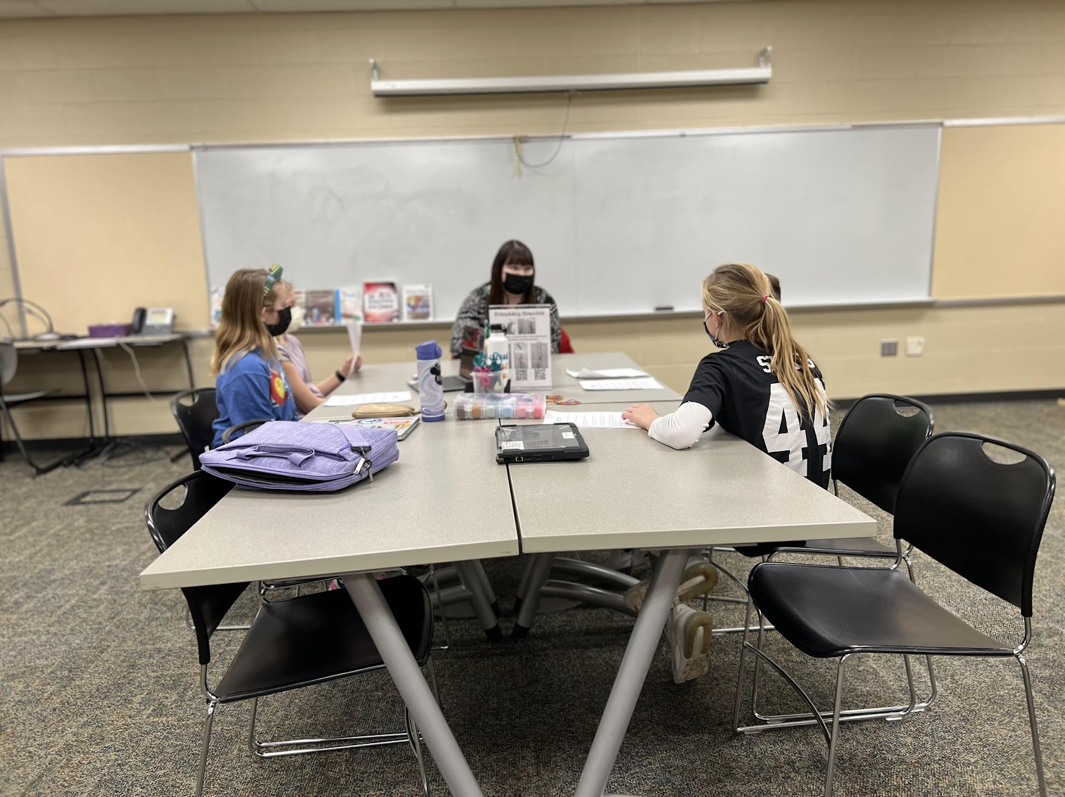
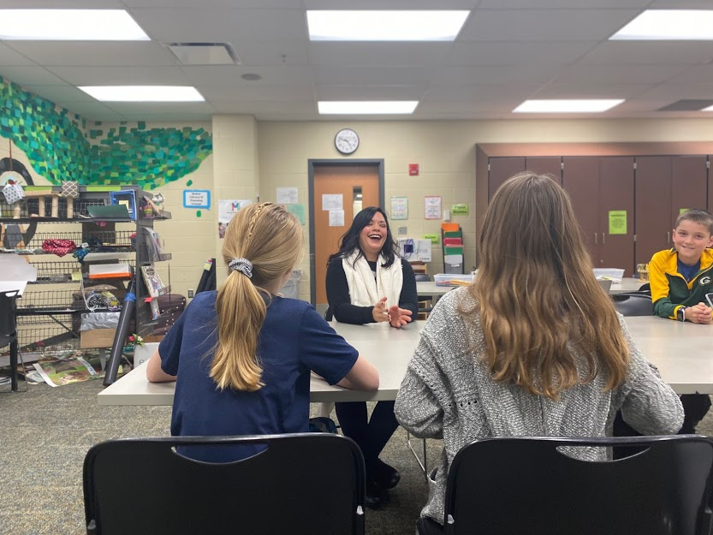
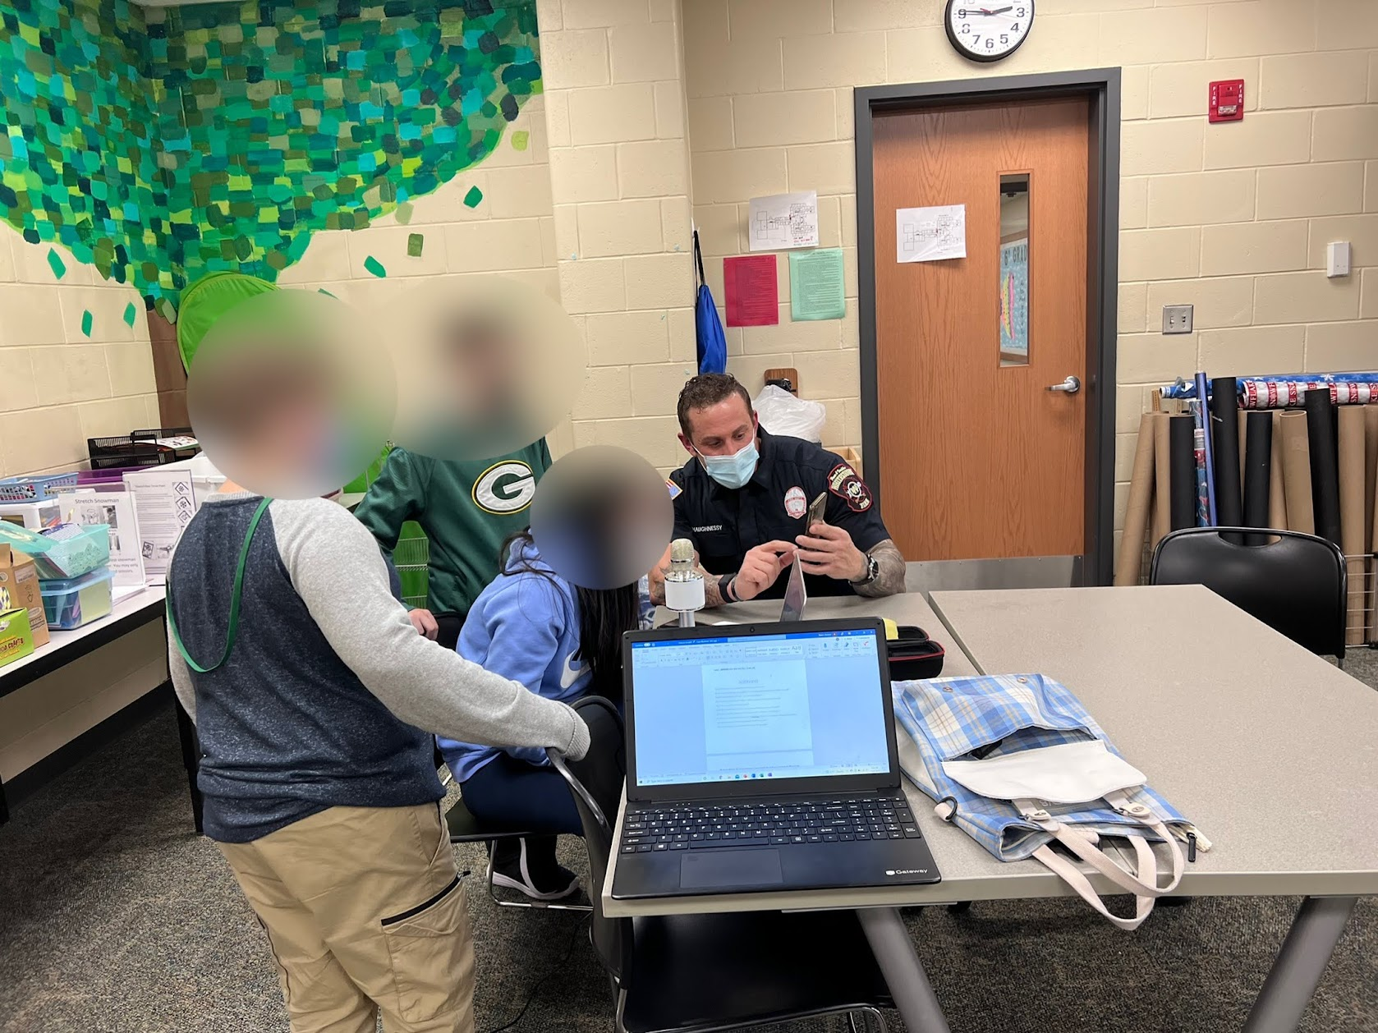
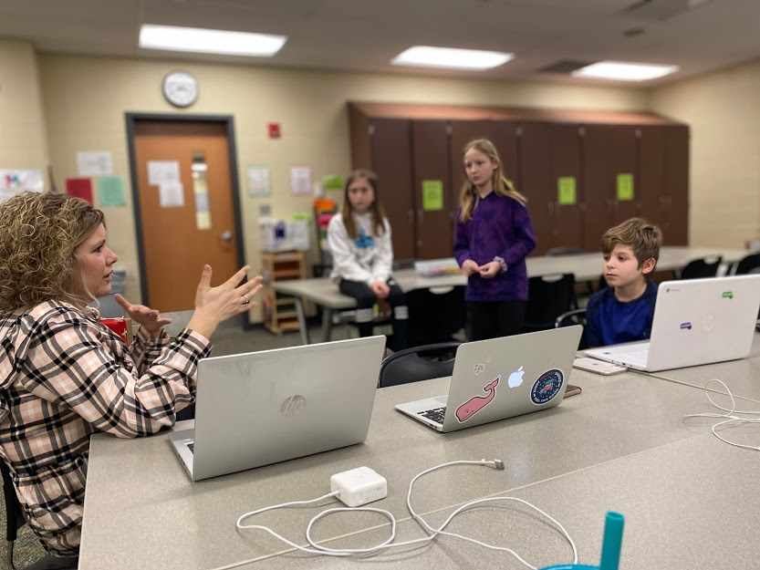
Interviews: Community Members

Slide 10
Just hit record!

Slide 11
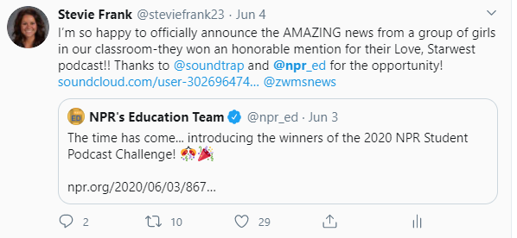
Publishing!

Slide 12
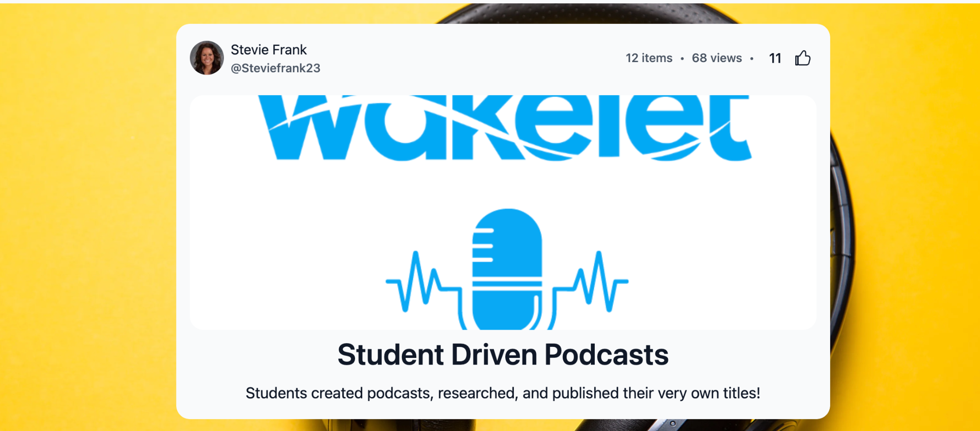
Publishing!

